Slide 1

CRS Workshop
11 September 2025

Slide 2

1.
Introduction

Slide 3
CRS Obligations
        Who?
  Financial Institutions (FIs)
Financial Institution
Custodial institution
Depository institution
Investment entity
Specified insurance company
Any entity that holds, as a substantial portion of its business, financial assets for the account of others
Any entity that accepts deposits in the ordinary course of a banking or similar business
Any entity that primarily conducts as a business (for example) investing, administering, or managing financial assets for or on behalf of a customer
Any entity that is an insurance company that issues or is obligated to make payments with respect to a ‘Cash Value Insurance Contract’ or an ‘Annuity Contract’

Slide 4
CRS Obligations
  What?
  Three obligations under CRS
Obligations FI
Identification
Reporting
Monitoring
Pre-existing accounts
New accounts
Monitoring
Reportable persons
Deadline is 31 March
Record steps undertaken & evidence relied upon
CRS Policy

Slide 5
2.
Changes of CRS

Slide 6

Changes of CRS
  Dynamic implementation
  The government of Curaçao will confirm when these changes must be incorporated in the CRS reporting
  Key changes in the consolidated text of CRS (2025)
  In the reporting:
  To be confirmed whether each Account Holder has a valid self certification form;
  The role(s) by virtue of which each Reportable Person is a Controlling Person; and
  Whether the account is a Preexisting Account or a New Account
  Further:
  Obtaining information of Preexisting Low Value Accounts if a TIN or date of birth is missing (now, additional information needs to be obtained if required from an AML/KYC perspective)
  In case of dual residency of an Account Holder, it is required that both CRS jurisdictions will be mentioned in the self certification form and that the Financial Institution must treat the Account Holder reportable in both jurisdictions (i.e., the tiebreaker rule in tax treaties is no longer relevant)
  Extension of the term Investment Entity (case example on next slide)

Slide 7
Changes of CRS
  Case example
  Relevant Crypto Assets
  Based on the 2025 changes, Financial Assets will also include Relevant Crypto-Assets
  Not to be mistaken with the Crypto Asset Reporting Framework (CARF) which, currently, is not proposed to be introduced in Curaçao
  Limited scope.
Investors
Investment Entity
Relevant Crypto-Assets
  Financial Assets

Slide 8
Changes of CRS
  Other changes
  The term Depository Institution will also include Entities that hold Specified Electronic Money Products (not the same as Crypto-Assets) or Central Bank Digital Currencies for the benefit of customers
  An account that that is used exclusively to deposit capital that is to be used for the purpose of the foundation or capital increase of a company (as prescribed by law) may qualify as an Excluded Account

Slide 9
3.
Case examples regarding identification

Slide 10
Case example
  Investment Entity
  For or on behalf of a customer
  Any Entity that primarily conducts as a business (for example) investing, administering, or managing financial assets for or on behalf of a customer is considered an Investment Entity.
  According to the CRS commentary, the term “customer” includes the Equity Interest holder of a collective investment vehicle, whereby the collective investment vehicle is considered to conduct its activities or operations as a business
  Therefore, also passive collective investment vehicles are considered to conduct a business (whose investors are the customers)
Investors
Collective Investment Vehicle
Investments

Slide 11
Case example
  Personal holding company exception
  For or on behalf of a customer
  Based on CRS guidance, there is no client relationship if an investment vehicle (e.g., a personal holding company that only holds investments) only has one shareholder.
  Therefore, a personal holding company will not qualify as an investment entity, if it is not managed by another financial entity.
Sole shareholder
Personal Holding Company
Investments

Slide 12
Case example
  Managed by
  Managed by
  An Entity is “managed by” another Entity if the managing Entity performs, either directly or through another service provider, (for example) investing activities on behalf of the managed Entity.
  Consequently, the personal holding company will qualify as an Investment Entity.
  However, an Entity does not manage another Entity if it does not have discretionary authority to manage the Entity’s assets (in whole or part).
Trust Service Provider
Sole shareholder
Personal holding company
Financial assets

Slide 13
Case example
  Family funds
  Change in Curaçao CRS Guidance
  Since 2024, family funds may no longer automatically qualify as a Passive NFE.
Family
Family Investment Vehicle
Financial assets

Slide 14
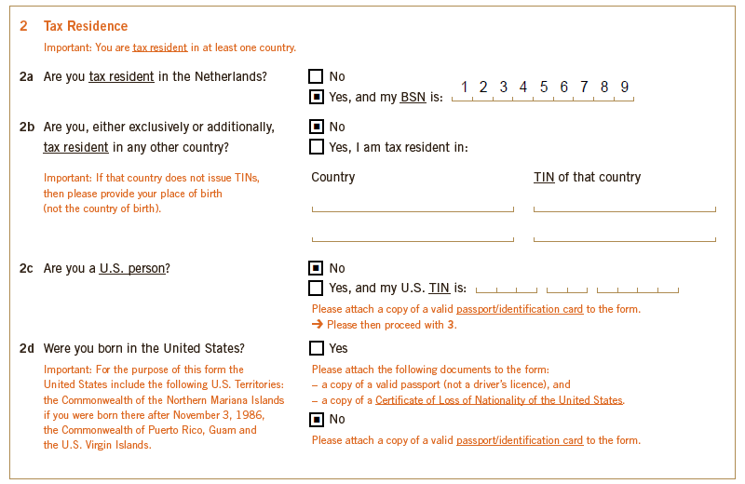
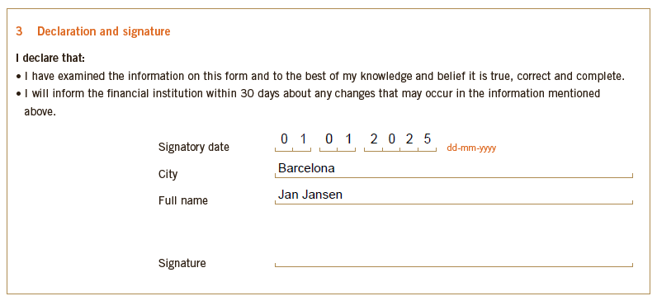
Case example
  An individual claims to be a tax resident of the Netherlands. However, the form is signed in Barcelona, Spain.
  Upon checking the relevant KYC, it turned out this person is a tax resident of Spain. Consequently, the provided self-certification form is invalid.

Slide 15
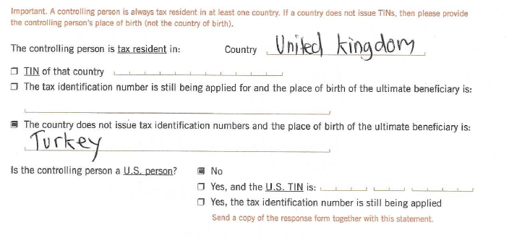
Case example
  This individual is a tax resident of the United Kingdom which, according to this induvial, does not issue tax identification numbers (TINs).
  Based on the CRS commentary, if a TIN is missing, the Reporting Financial Institution must check the website of the OECD regarding the structure and issuance of TINs in OECD countries.
  In this case, strictly speaking, the United Kingdom does not issue TINs. Accordingly, a functional equivalent must be included in the self-certification form (which does exist).

Slide 16
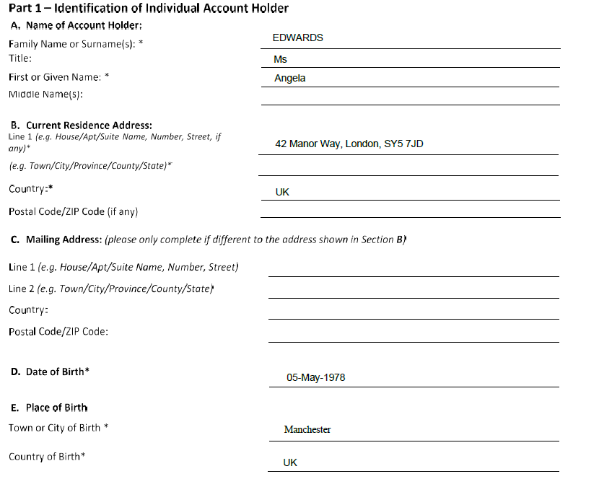
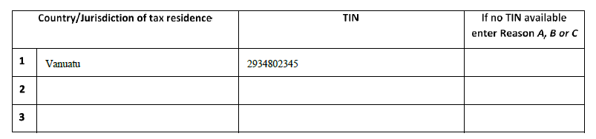

Case example
  This individual claims to be a tax resident of Malta while her residence address is in London, United Kingdom.
  Malta is known for having a residence by investment scheme.
  Based on the CRS commentary, further questions must be raised by the Reporting Financial Institution to confirm the tax residence of the new Account Holder as there is a high risk of abuse (i.e., no information is exchanged with the United Kingdom based on this self-certification)
  Further, dual residency may apply.

Slide 17

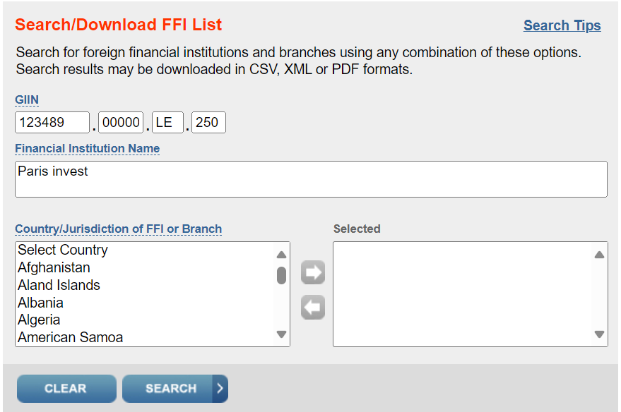
Case example
  Does having a GIIN justify the conclusion that Paris Invest is a financial institution?
  No, having a GIIN is insufficient to conclude that there is no reportable person. The question whether Paris Invest is a financial institution, must be reasonably determined on the required KYC.
  Moreover, potentially, there may even be abuse, because based on the deemed qualification of Paris Invest as a financial institution, no information will be exchanged by ABC Bank regarding Paris Invest bank account.

Slide 18
4.
Reporting

Slide 19
CRS – Reportable persons
Natural persons
CRS
Tax residency in another CRS jurisdiction
Entities
Reportable entity
Passive NFE or Active NFE with tax residence in CRS-jurisdiction, except for:
  A(n organisation related to a) listed corporation;
  a governmental entity,
  an international organization,
  a central bank, or
  an FI
Reportable UBO Passive NFE
UBO with tax residence in CRS-jurisdiction

Slide 20
CRS – Reportable information
Name, address
Tax identification number (TIN)
Gross distributions
Date of birth
Reportable information
Q4 value financial account
Name of reporting FI
        Reporting deadline: 31 March

Slide 21
5.
Monitoring

Slide 22
CRS – Monitoring
  Obligations during the lifetime of the account
  Self-certification forms are valid indefinitely, unless there are changed circumstances that give an FI knowledge or reason to believe that the original form is incorrect or unreliable (90 calendar days grace period).
  A relevant change in circumstances may lead to:
    a person becoming a reportable person,
    a person ceasing to be a reportable person,
    a reportable person must now be reported to multiple countries; or
    a reportable person must now be reported to another country.
  In the event of any relevant change of circumstances, each Reporting FI must send the relevant account holder a self-certification form to have the (suspected) new CRS status confirmed, or to have the current status reconfirmed. This applies to both natural persons and entities.
  Each FI is expected to institute procedures to ensure that any change that constitutes a change in circumstances is identified by the FI. In addition, an FI is expected to notify any person providing a self-certification of the person’s obligation to notify the FI of a change in circumstances.
  However, an FI may rely on a self-certification without having to inquire into possible changes of circumstances that may affect the validity of the statement, unless it knows or has reason to know that circumstances have changed.
  In respect of reportable accounts, it is key to report the TIN and for individuals also the date of birth.

Slide 23


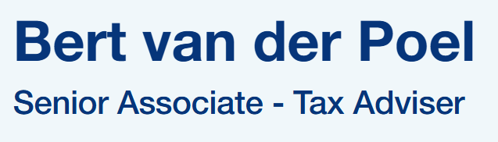

Contact details

