Slide 1

CRS Seminar for FI’s
10 June 2025

Slide 2
Agenda
Welcome & Introduction Jamila Isenia
Penalty policy Runela Sillé
Info.aeoi@gobiernu.cw mailbox Runela Sillé
Technical issues MDES Otmar Tromp
Update onsite visit OECD Germaine Rekwest
Q&A

Slide 3
Draft Policy on administrative penalty; article 28 LIBB
A minimum of XCG 100.000 and a maximum of XCG 250.000. Policy takes recurrence into account
Categories
A. Warning
B. Penalty with regard to non/partially fulfillment of submission of
data/information
C. Penalty with regard to non/partially fulfillment of due diligence and
administration obligation
D. Penalty with regard to Self Certification Form
E. Penalty with regard to circumvention

Slide 4
Inbox info.aeoi@gobiernu.cw
The use of this email address is for all inquiries
- Please do not communicate through our personal email addresses with regard to AEOI/CRS issues
Most common questions regard the following aspects:
A. Technical aspects
B. Administrative aspects
C. Legal aspects

Slide 5
Technical issues MDES portal – Welton Adam

Slide 6
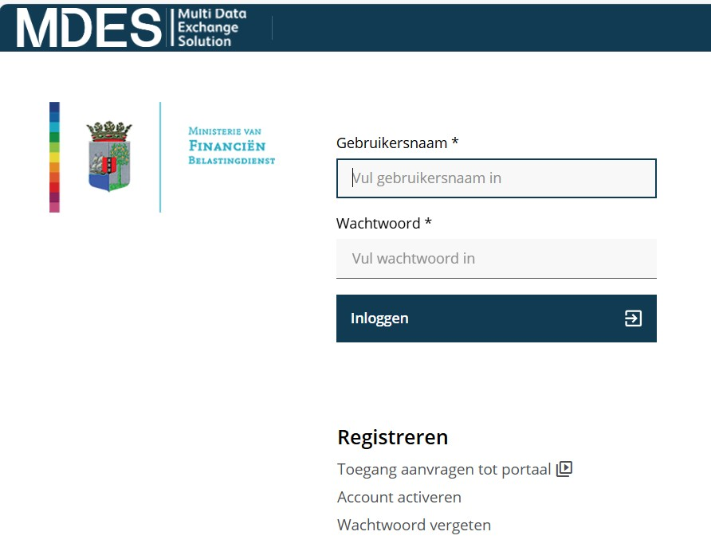
Responsibility of financial institutions
Password resetting
MDES Portal
User-Related Reasons
Forgotten password
Multiple failed attempts
Account ownership transfer

Slide 7
Onsite visit OECD Germaine Rekwest
Onsite visit
29 September – 3 October 2025

Slide 8

Curaçao should identify its FI population, and its classification for CRS purposes:
Identify yourself if you are a Reporting Financial Institution in Curaçao, to be classified as:
Depository Institution
Custodial Institution
Investment Entity
Type A: investment Entity Manager (for example Trust Service Provider)
Type B: investment Entity, being managed by a Type A Manager (for example a trust, a fund, etc.)
Specified Insurance company

Slide 9
Private sector meeting Depository institutions, Specified Insurance Companies, Investment Entities and Custodial Institutions
Experiences, practices in and challenges in implementing the requirements, including
Reflections on Curaçao’s approach to implementation
Particular challenges faced and any response to these challenges
Preventing circumvention
Excluded Accounts
Engagement with the tax authority with respect to the AEOI Standard, including communication channels, outreach and implementation

Slide 10
Investment Entities and Custodial Institutions
A representative sample of regulated and unregulated Investment Entity representatives, such as investment funds, trust representatives, professional trustees and TCSPs and Custodial Institutions. Should include compliance officer(s)/others involved in AEOI implementation (e.g. 8-12 representatives)

Slide 11
Discussions on:
What have been the main challenges encountered in implementing the CRS requirements?

Slide 12
Discussions on:
What changes, if any, did you need to make to onboarding procedures in order to identify Controlling Persons since the CRS was introduced?
How widespread is the collection or validation of self-certifications after the opening of the account?

Slide 13
Discussions on:
How common do you think the practice of Account Holders or Controlling Persons providing false self-certifications is? How do you respond if this practice is identified?
What challenges, if any, do you have encountered in determining which accounts meet the definition of Excluded Accounts?

Slide 14
Q&A and Wrap up
Next CRS Seminars in 2025:
11 September
(CRS workshop for FI’s by CRS experts)
3:00-5:00 PM
Renaissance Hotel
23 October
4:00-5:00 PM
Renaissance Hotel

